Slide 1

Cultural Evolution
Learning Intention:
Today we are learning about the evolution of tool use in hominid species.
Success Criteria:
Identify different cultural periods.
Describe examples within each hominin species.

Slide 2



Slide 3
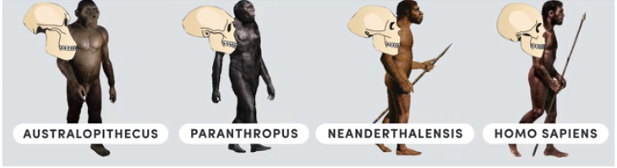
Cultural Evolution
Anthropologists (the people who study human societies and their development) may define culture anything that is learnt.
Language, tools and hunting techniques are all elements of culture.
Just as physical characteristics of hominins has evolved over time, hominin culture has also evolved.
Cultural development was an important means of overcoming some of the environmental challenges faced by early humans.
This cultural evolution has culminated in the highly complex culture we have today.

Slide 4
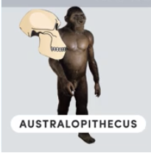
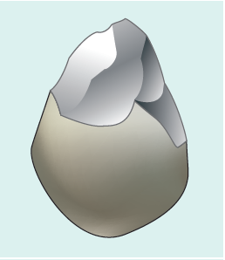
13.3 Cultural evolution
Tool use by australopithecines
No evidence of the use of fire by australopithecines has been found to date, but tool use does appear to have been common.
A range of pebble tools have been found, including choppers, scrapers, flakes and chisels. These vary from about the size of a tennis ball (choppers) to that of a marble (scrapers and flakes), and are frequently referred to as Oldowan tools.
To use the scrapers effectively, the precision grip must have been employed. Tools of this type have been found at sites dating back 2.5 million years.

Slide 5
13.3 Cultural evolution
Tool use by australopithecines
This early tool making marked the start of a change in the way hominins interacted with their environment.
They used items present in their surroundings, such as pebbles, sticks and plant material. However, there is no evidence suggesting that they changed these tools.
These simple pebble tools enabled the australopithecines to exploit the resources in their environment more effectively and were the first stage in a succession of cultural changes still going on today.

Slide 6
13.3 Cultural evolution
Tool use by Homo habilis
Homo habilis continued to use Oldowan tools. Some of these were sharpened or shaped by striking one stone with another.
These would have been used for activities such as skinning animals, chopping up meat, breaking open bones, crushing plants and digging up edible plant roots.
Homo habilis lived in grasslands and were hunter-gatherers. Their diet would have been primarily plant material, with supplementary meat from either scavenging or hunting.

Slide 7
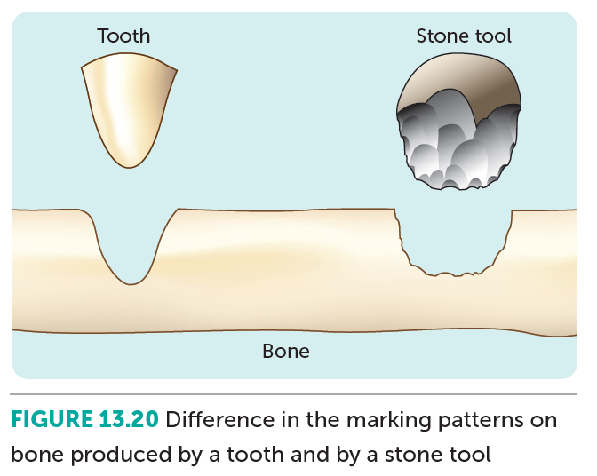
13.3 Cultural evolution
Tool use by Homo habilis
Typically, hunter-gatherers would have worked in groups, with specific members being responsible for different tasks. Those collecting food would have brought it back to the home base to share among the members.
This indicates a social organisation in Homo habilis. Communication within the group would have been important, and thus pressure for development of a spoken language would have increased.
There is some evidence that early Homo had a bulge in the speech-producing area of the brain, but the larynx may not have been capable of making complex sounds.

Slide 8
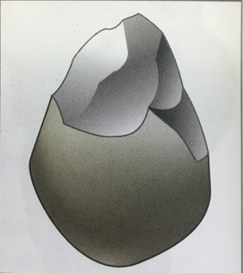
Guided Notes
Common Name | Scientific Name | Approximate age range (Years BP) | Cultural Period | Example
Australopithecines | Australopithecus sp. Homo Habilis | 2.6 – 1.7 million | Oldowan Simple river-worn pebbles that were crudely fashioned with minimum of flakes being removed. Flakes knocked from several angles to produce a core with a cutting edge → useful in cutting

Slide 9
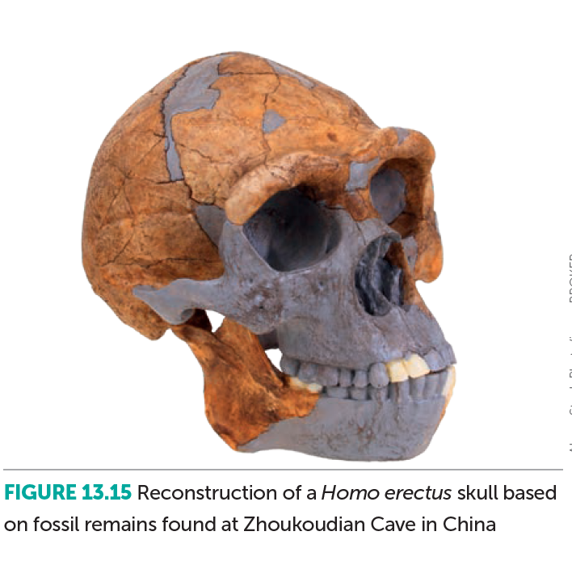
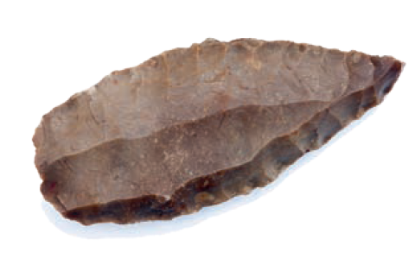
13.3 Cultural evolution
Tool use by Homo erectus
By the time of Homo erectus, the effect of the environment as a selective agent was diminishing.
The use of fire, the building of shelters and a range of sophisticated tools had enabled H. erectus to become more independent of the environment.

Slide 10
13.3 Cultural evolution
Tool use by Homo erectus
Tools manufactured by H. erectus were flaked around all of the edges, first in one direction and then in the other, until they formed roughly two-faced (bi-faced) lumps, approximately teardrop in shape.
These tools were used as hand axes and are usually referred to as Acheulian tools.

Slide 11
13.3 Cultural evolution
Tool use by Homo erectus
Cultural changes such as the use of fire and the manufacture of tools would have influenced the social organisation of H. erectus.
Greater emphasis must have been placed on mutual cooperation, and a complex society began to be established in which the care of the young would have gradually become increasingly important.
A relatively complex spoken language could have arisen at this time, but is impossible to establish from the fossil record.

Slide 12
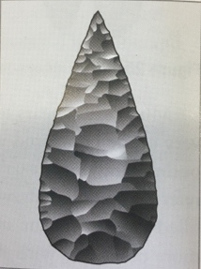
Guided Notes
Common Name | Scientific Name | Approximate age range (Years BP) | Cultural Period | Example
Homo erectus | Homo erectus | 1.7 million – 200 000 thousand | Acheulian ‘tear-drop’ shape, most likely used as a hand axe Differ from Oldowan as many more flakes have been taken out

Slide 13
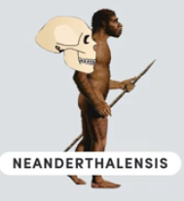
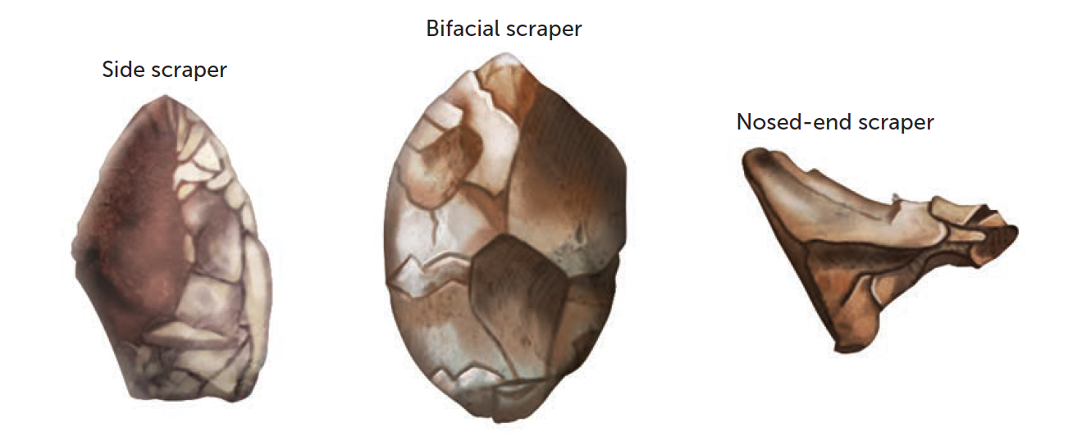
13.3 Cultural evolution
Tool use by Homo neanderthalensis
By the time of later hominins such as Homo neanderthalensis, further cultural advances had greatly diminished the importance of the environment in determining how and where they lived.
Tool making now involved the production of stone flakes that could then be trimmed to form various cutting, scraping, piercing and gouging tools.
Commonly referred to as the ‘Mousterian industry’, these tools showed a cultural advance over the Acheulian hand axe. A piece of stone was first trimmed into a disc-shaped core, and then struck by another piece of stone to produce the flakes that were flat on one side and had sharp edges.
This technique is known as the Levallois technique.

Slide 14
13.3 Cultural evolution
Tool use by Homo neanderthalensis
The flake tools could also be joined on to a handle, spear or arrow in a process called hafting.
The Lavallois technique and hafting required planning and the ability to foresee possible outcomes. This indicates a significant development in the cognition of the species.

Slide 15
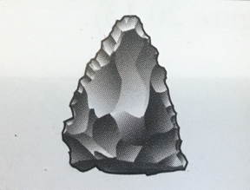
Guided Notes
Common Name | Scientific Name | Approximate age range (Years BP) | Cultural Period | Example
Neanderthal | Homo Neanderthalensis | 200 000 – 40 000 thousand | Mousterian manufacture of flake tools. More refined tool culture than Acheulian, flint became preferred material to make stone tools (predictable way in which it would chip when struck with another hard object → much finer workmanship)

Slide 16
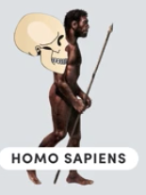
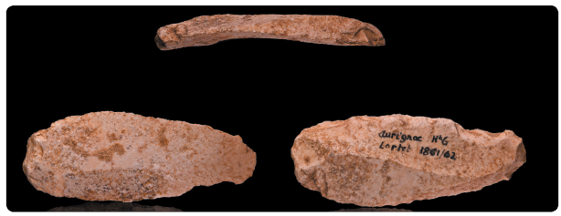
13.3 Cultural evolution
Tool use by Homo sapiens
Around 50 000 years ago, new technologies associated with modern humans – finer blades and projectile weapons – began to appear. Scientists can only speculate on what triggered this technological spurt.
Whatever the cause, around 40 000 years ago modern humans moved into Europe. They brought with them innovations such as clothing, which had been sewn, and better shelters. These modern humans, known as the Cro-Magnon people, became well established in Europe and were the makers of blade tools – flakes of stone with roughly parallel sides.

Slide 17
13.3 Cultural evolution
Tool use by Homo sapiens
When the first fossil remains were found at Cro-Magnon in 1868, the tools found with them were similar to those found eight years earlier at Aurignac, which had become known as Aurignacian tools.
These were blades made by removing long, flat rectangles from the core stone, which were easy to handle and effective in cutting.
Aurignacian blade shown from three angles

Slide 18
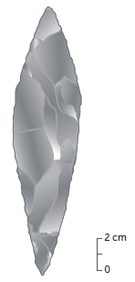
13.3 Cultural evolution
Tool use by Homo sapiens
Two other cultures are associated with later Cro-Magnon people: the Solutrean and the Magdalenian. The Solutrean culture was characterised by beautifully made willow-leaf and laurel-leaf points.
These were made by carefully retouching blades produced from the original stone core by pressure flaking.
Solutrean ‘laurel-leaf’ blade

Slide 19
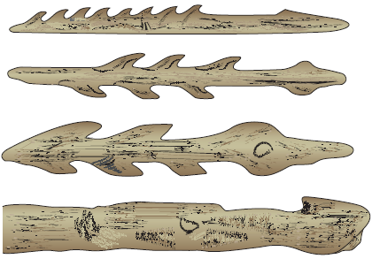
13.3 Cultural evolution
Tool use by Homo sapiens
The Magdalenian cultural period, which followed the Solutrean, is known for the dominance of bone and antler tools over those of flint and stone, and for the works of art that were produced during this period.
The bone and antler tools were made using a burin, or chisel-like cutter, a tool used for the manufacture of other tools. This was a significant advance in tool making: humans had devised a tool for making other tools.
Magdalenian barbed points and spear thrower (bottom) made of bone or antler

Slide 20
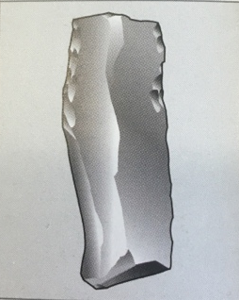
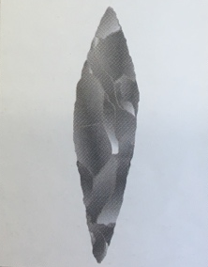
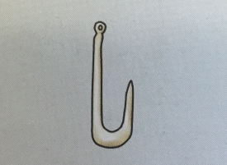
Guided Notes
Common Name | Scientific Name | Approximate age range (Years BP) | Cultural Period | Example
Cro-Magnon | Homo sapiens | 43 000 – 26 000 thousand | Aurignacian manufacture of blade tools
Cro-Magnon | Homo sapiens | 22 000 – 19 000 thousand | Solutrean pressure flaking to retouch blades
Cro-Magnon | Homo sapiens | 18 000 – 12 000 thousand | Magdalenian predominance of bone + antler tools + artwork

Slide 21
13.3 Cultural evolution
Trends in tools
During the course of human evolution, some general trends are evident:
increased manipulation of materials
increased complexity of tools
greater variety of materials being used to make tools
improved workmanship and development of equipment needed to manufacture the tools
increased specialisation of tools.
These trends, alongside structural changes during evolution, allow us to infer changes in lifestyles. Collaboration would have increased, requiring effective communication.
Members within a group would have developed more specific roles and skills. Planning and creativity became important, and humans started manipulating the environment to meet their needs.

